Slide 1
C389 CA1 Presentation
Team 2 – Luggage
Team members: Chen JunRu, Fang SiWen, Ashton, Naufal

Slide 2
Twist Design and Technique Choice:
1.1 Twist goal
Detect person-luggage interactions and count luggage-carrying pedestrians.
1.2 Boundary Definitions
Carrying Luggage
Count: Person holding, pulling or pushing luggage
Does not count: Person Holding small personal items (e.g., phones, coffee) or standing near luggage without contact.
Moving Left
Count: Person walking towards the left side of the screen.
Does not count: Person standing still, moving right, or moving straight towards/away from the camera.
Moving Right
Count: Person walking towards the right side of the screen.
Does not count: Person standing still, moving left, or moving straight towards/away from the camera.
1.3 Technique Trade-off and Selection
Chosen Architecture:
4-Class Direct Detection Model
Classes: person_left, person_right, person_with_luggage_left and person_with_luggage_right
Why chosen: Single forward pass eliminates multi-frame tracking errors and reduces deployment latency.
Why rejected others: Too slow for real-time use and unreliable in crowded scenes

Slide 3
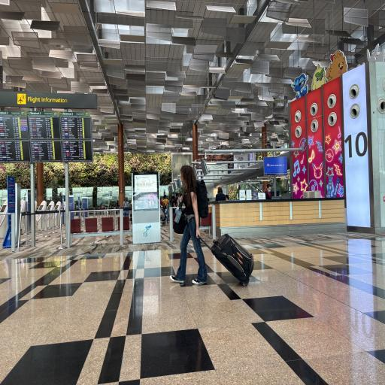
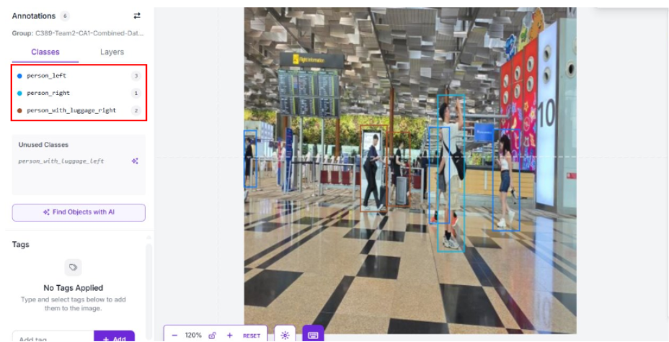
Implementation:
How the twist is built on the baseline:
1. Capture:
The twist requires us to capture additional images of luggage-carrying pedestrians.
2. Annotate:
The twist expends the scope and the criterion of annotation for two additional classes that need to be detected.

Slide 4
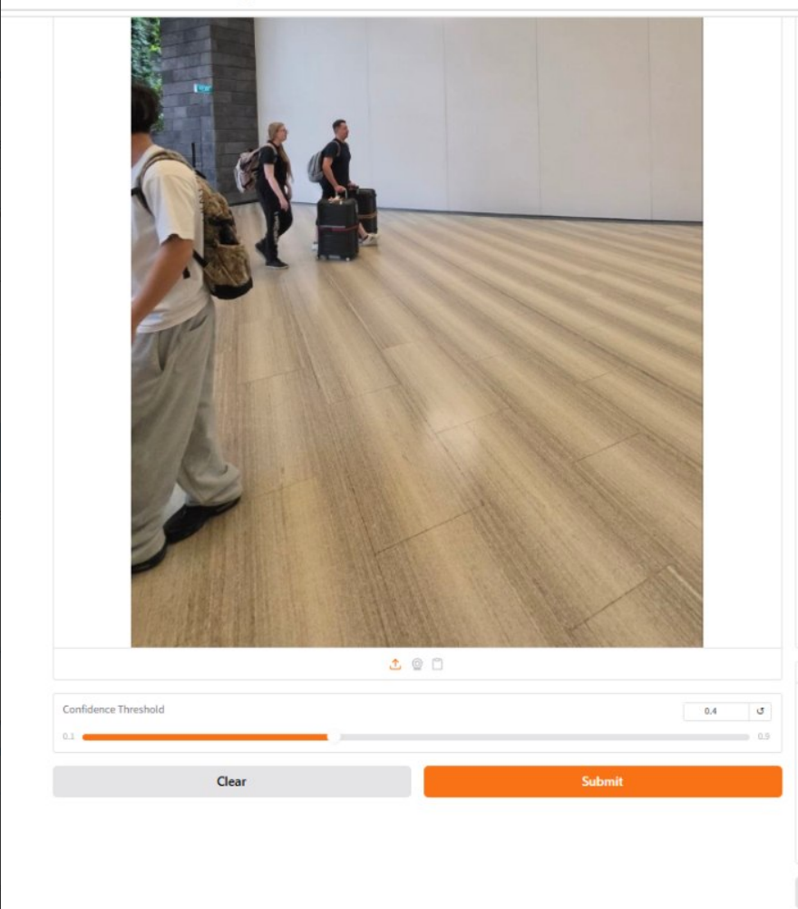
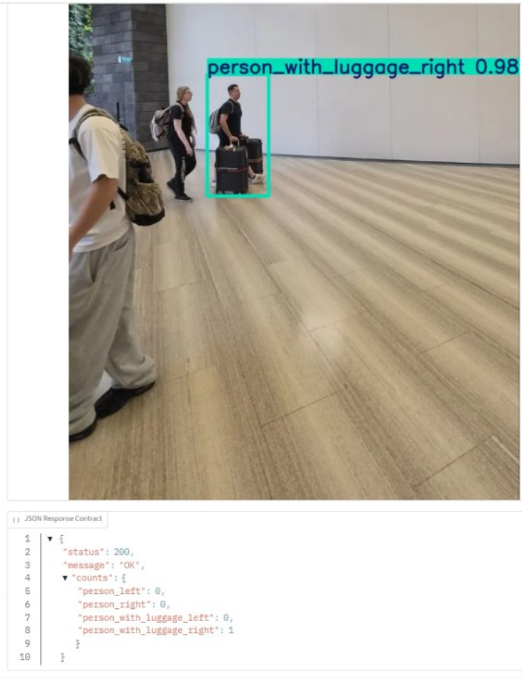
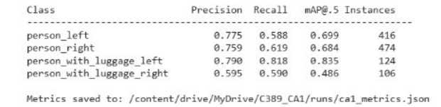
Implementation:
How the twist is built on the baseline:
4. Detect:
Run the trained model on new twist images that contain luggage-carrying pedestrians.
5/6. Count & Report:
The twist adds two more class instances in dataset that need to be summed up and presented.

Slide 5
Implementation:
Problems we met:
Our team was not clear about the scope of the objects of twist that the model needs to detect when we were annotating images.
What we did:
We clarified the twist requirements with the teacher and reviewed the objectives of the twist.
Decision made:
We excluded luggage from the objects that the model needs to detect, the model will only detect the directional motion of pedestrians and pedestrians carrying luggage.

Slide 6
Implementation:
Problems we met:
After deploying trained model on Gradio page, we found that it was better at detecting pure pedestrians' directional motion rather than luggage-carrying pedestrians' directional motion.
What we did:
We found the number of imbalanced data between the baseline data and the twist data in our dataset.
Decision made:
We captured and added more images that related to the twist to the dataset to ensure the performance of the model is free from the bias.

Slide 7
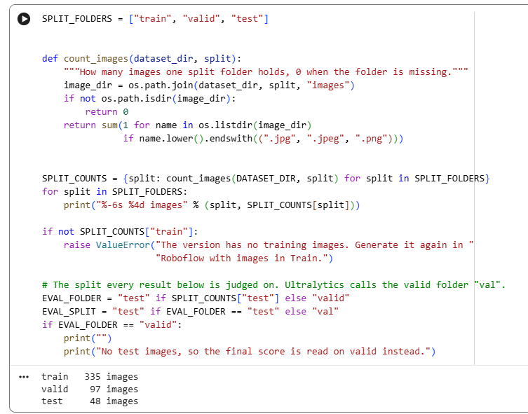
Evaluation
Test Evaluation
YOLO object detection | Final evaluation on valid held-out test images
Dataset split
Train: 335 images
Validation: 97 images
Test: 48 images originally
Final test set
1 image excluded due to incorrect mixed segmentation/detection annotations
47 valid images • 118 objects
Ground truth: objects were manually annotated in Roboflow..

Slide 8
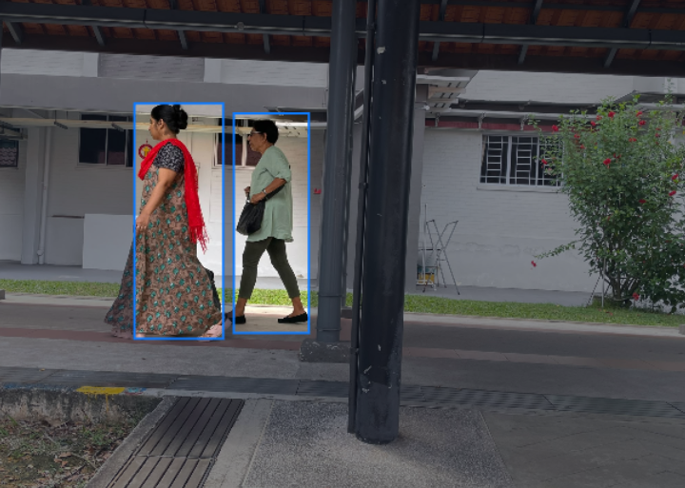
MODEL EVALUATION / YOLO26 DIRECTION CLASSIFIER
Evaluation
EVALUATION PROTOCOL
Run inference
Record predictions
Capture each bounding box, predicted class and confidence score.
Compare with ground truth
Manually annotate this image, then assess class and detection errors.
Run inference
Do not report counts, accuracy or precision/recall until the model is run and predictions are checked against ground truth. This single image is a qualitative external check—not a replacement for the held-out test-set metrics.
Process validation images using YOLO26. Generate bounding boxes, direction classes and confidence scores.

Slide 9
Evaluation Result
Evaluation results
Precision
Recall
0.730 (73.0%)
0.654 (65.4%)
mAP@50
mAP@50–95
0.676 (67.6%)
0.391 (39.1%)

Slide 10
Failure Analysis
Failure Analysis & Limitations
What the test results tell us and what they do not
Main findings
Recall (65.4%): some real objects were missed.
Precision (73.0%): some predictions were incorrect.
mAP@50 (67.6%) vs mAP@50–95 (39.1%): stricter box-overlap requirements reduce performance.
Limitations & honest reporting
Only 47 valid test images and 118 annotated objects were evaluated.
One of the original 48 test images was excluded because it contained mixed annotation segmentation and its object detection labels were incorrect.
Results may not represent every real-world condition; more diverse test data is needed.

Slide 11
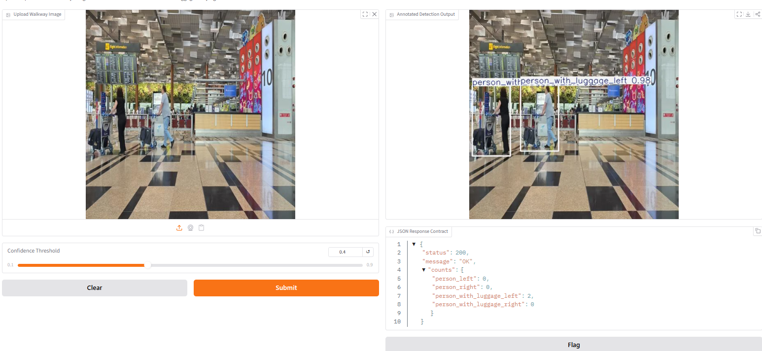
Deployment

Slide 12
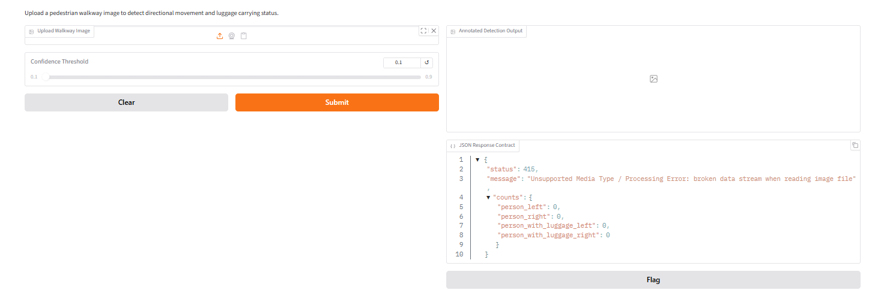
415 Unsupported Media Type

Slide 13
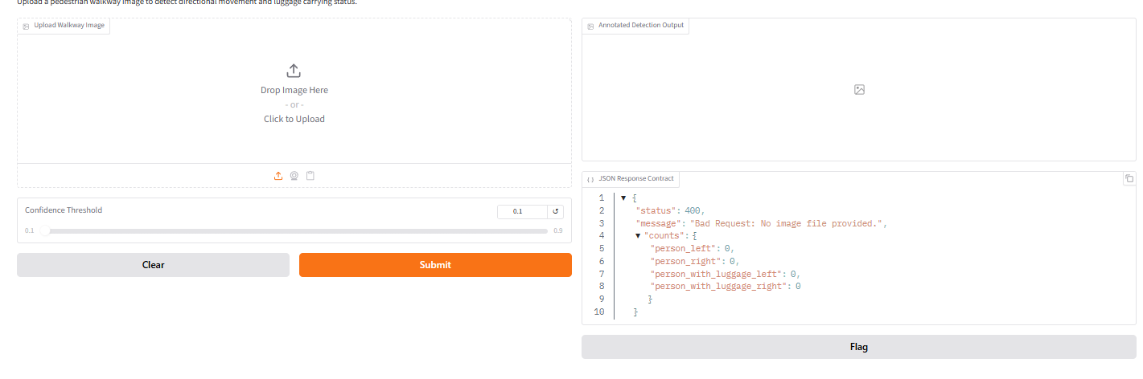
400 Bad Request

Slide 14
Thank you for listening !

